Slide 1
Docker For Software Engineers
Docker

Slide 2
What is Docker?
Docker is a platform for creating, running, and managing containers.
A container is a lightweight, portable, and isolated environment for running applications.

Slide 3
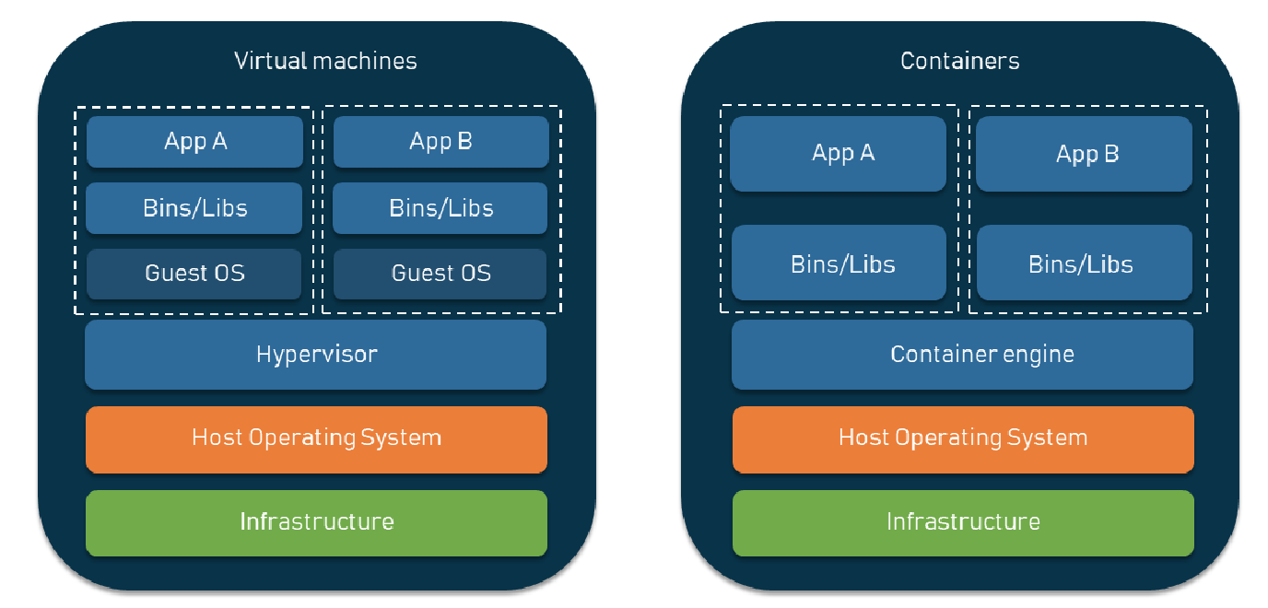
Docker vs. Virtual Machines

Slide 4
Why Do We Need Docker?
"It works on my machine!" problem.
Different environments = different results.
Easy to share and deploy software anywhere.
Faster setup for development, testing, and production.

Slide 5
Docker Concepts
📦 Docker Image: A read-only template containing all the necessary files, libraries, and dependencies required to run an application in a Docker container.
🐳 Docker Container: A running instance of an image — an executable package including the code, libraries, and dependencies needed to run the application.
📄 Dockerfile: A script containing instructions to create a Docker image. It defines everything needed for the image: base image, commands, dependencies, and files.
📦 Docker Registry: A repository for storing, sharing, and managing Docker images. Examples: (Docker Hub - Amazon Elastic Container Registry - Azure Container Registry - Google Cloud Container)

Slide 6
Docker Concepts
⚙️ Docker Engine: An application for managing Docker containers. It includes:
Docker Daemon (server process)
Docker Client (command line tool)
📦 Docker compose: is a yaml file to run multiple containers. It can be defined outside the application code.
📂 Docker volume: is a folder shared between host file system and virtual file system of docker container.
🌐 Networks: A way for Docker containers to communicate with each other. Docker networks allow containers to interact securely by controlling traffic between them.

Slide 7
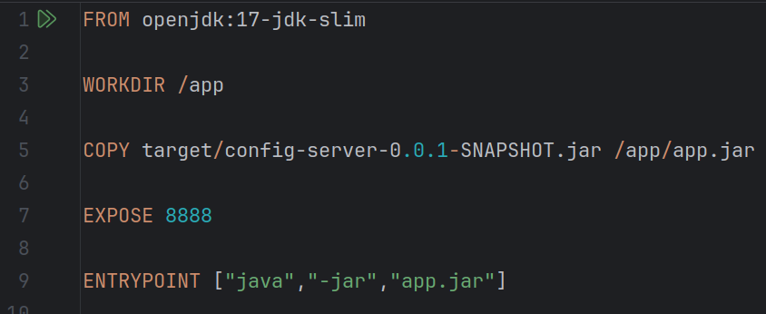
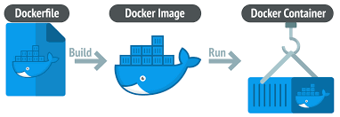
How Docker work?
Write a Dockerfile
Build an Image
Run a Container from the Image
Stop, Restart, or Remove the Container

Slide 8
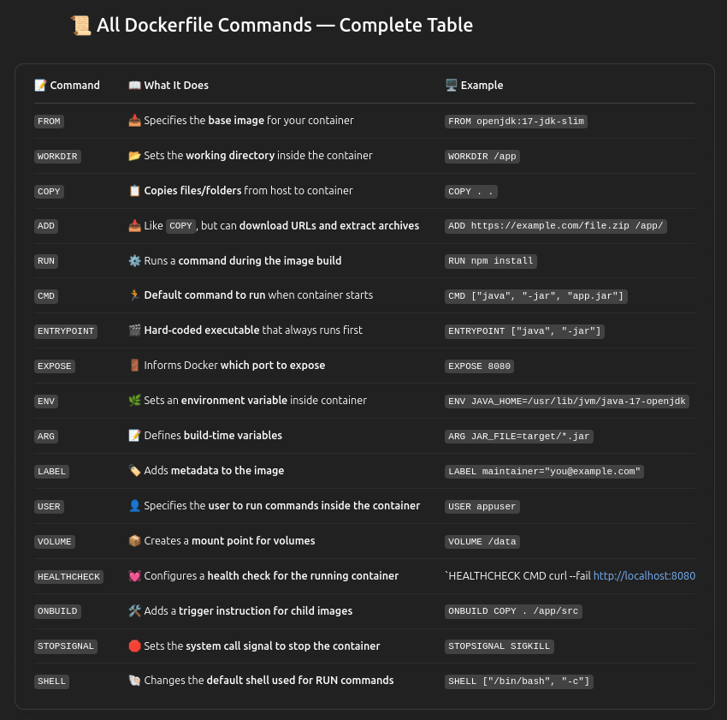
How Write Dockerfile?

Slide 9
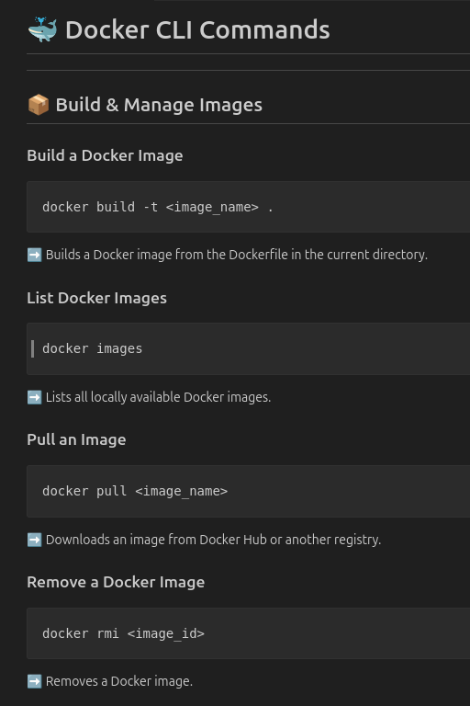
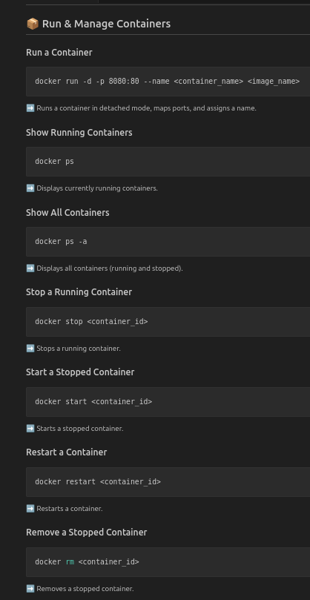
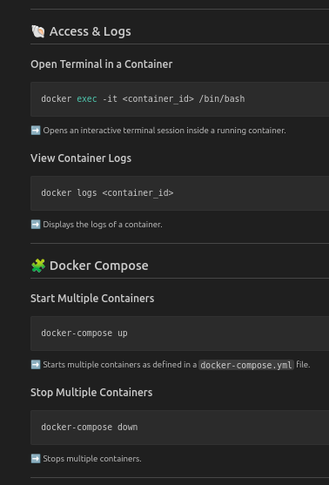
Docker CLI

Slide 10
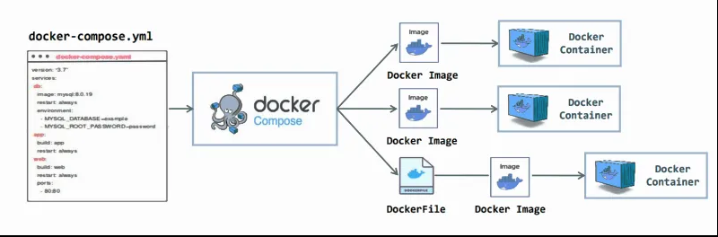
Docker Compose
📦 Docker compose: is a yaml file to run multiple containers. It can be defined outside the application code.

Slide 11
Resources
Repo : https://github.com/Abdelrahman-Magdii/Docker_CLI_Commands-Dockerfile_Commands.git

Slide 12
Thank You

